Slide 1
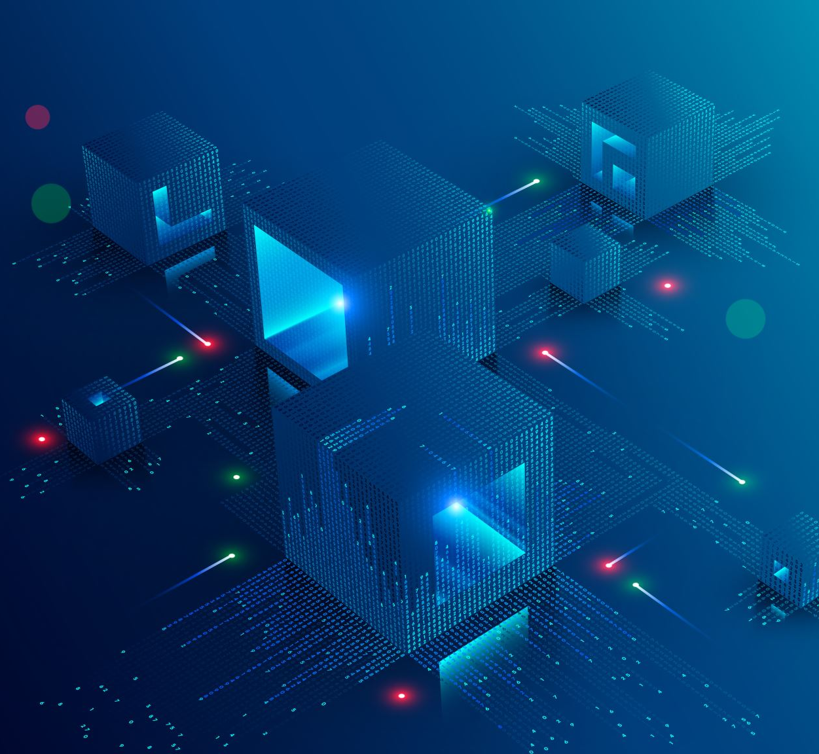
Session 6
Creating a basic UI
Losing/Restarting
Sounds

Slide 2
Useful Sites
Icons: https://game-icons.net/
Fonts: https://www.dafont.com/
Colour Pallets:
https://material.io/resources/color/
https://coolors.co/generate

